Slide 1

Pentecost Sunday, May 24, 2026

Slide 2


Slide 3

The Unreached
Still Wait
  There are more than 3 billion unreached people, yet less than 450,000 known missionaries worldwide—from all Christian traditions. The task before us is immense, but the opportunity for our church is just as great.

Slide 5
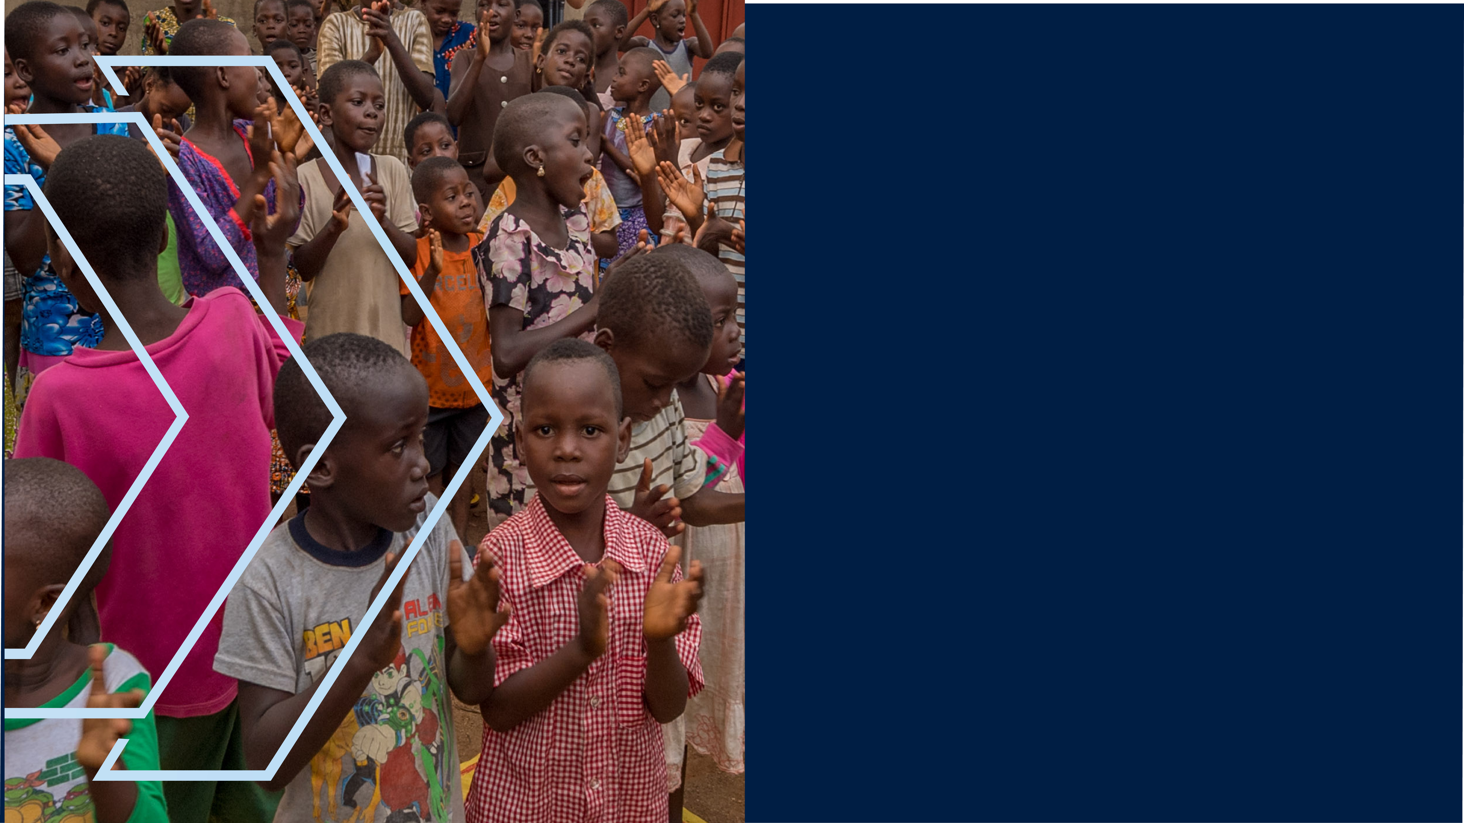

Slide 6
