Slide 1
[First and First LastName]
[Sending Church]

Slide 6
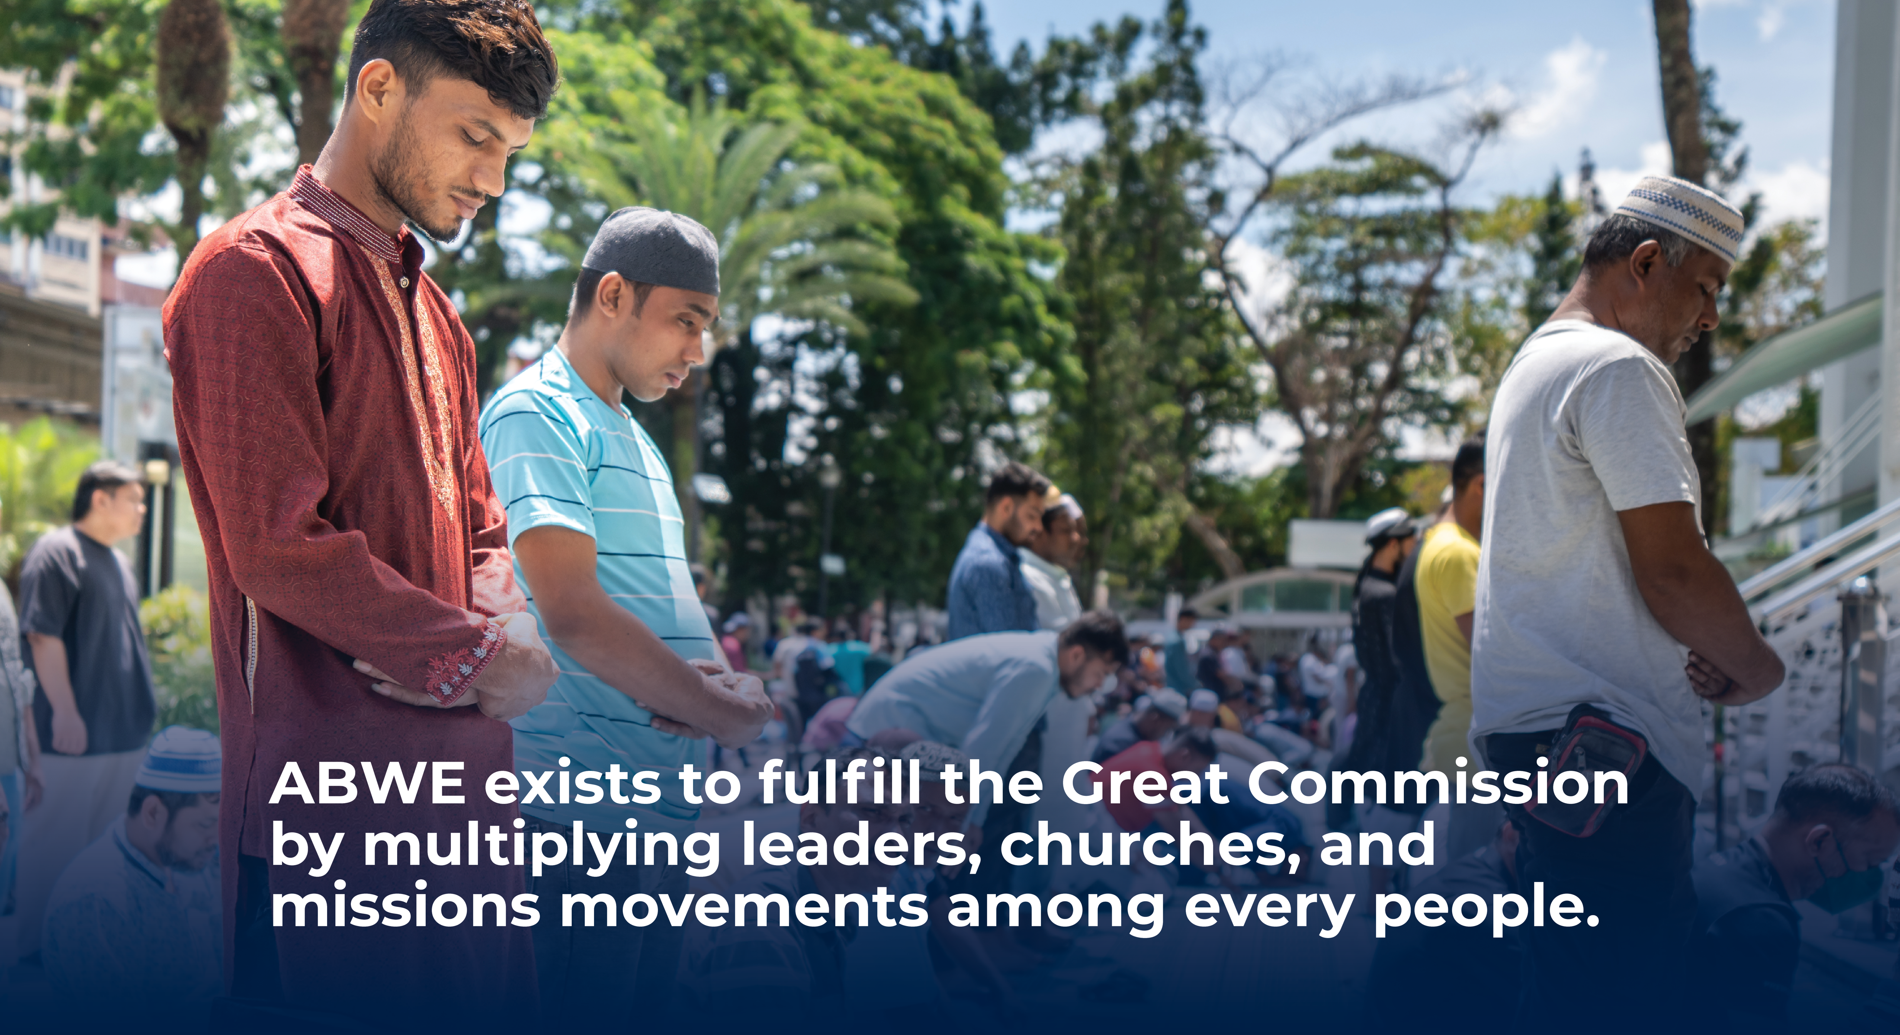

Slide 7
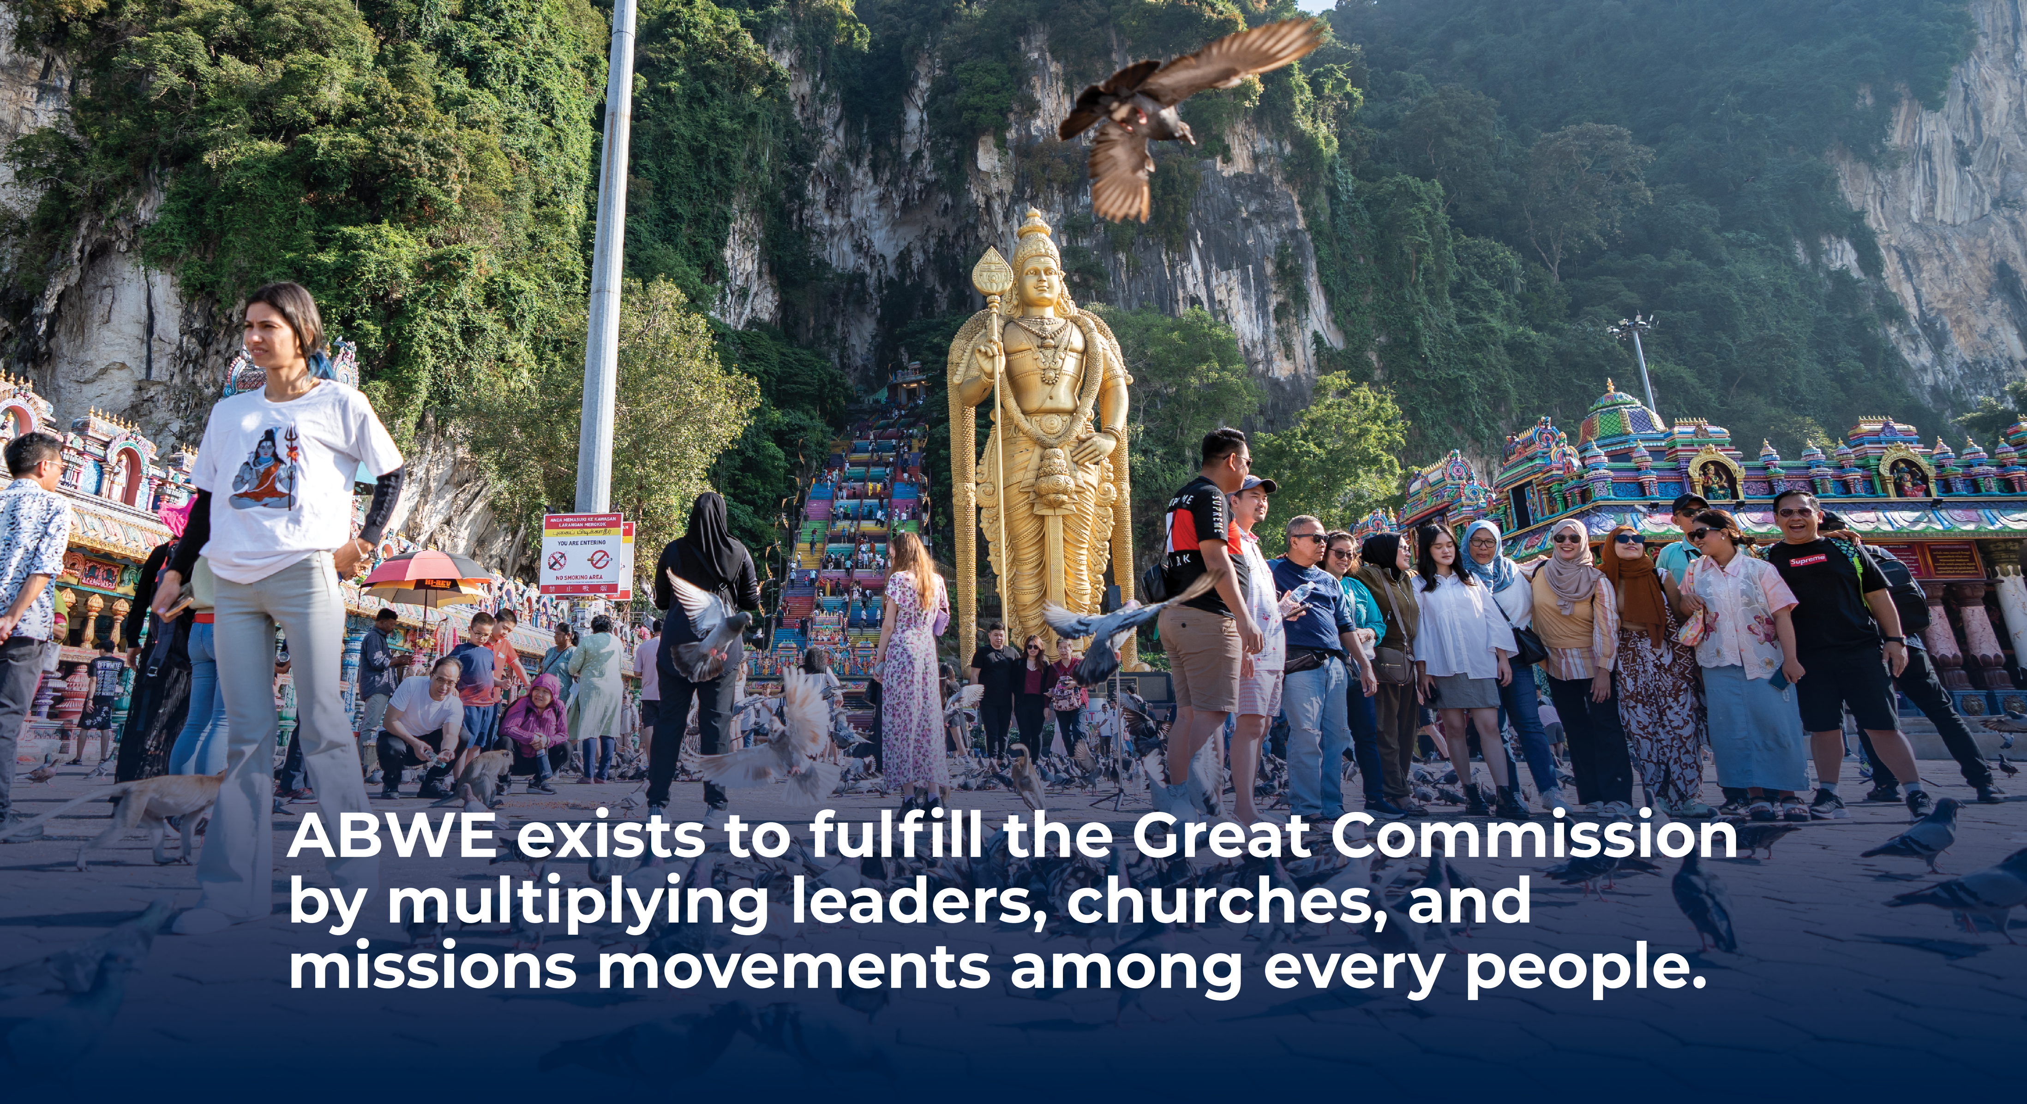

Slide 8
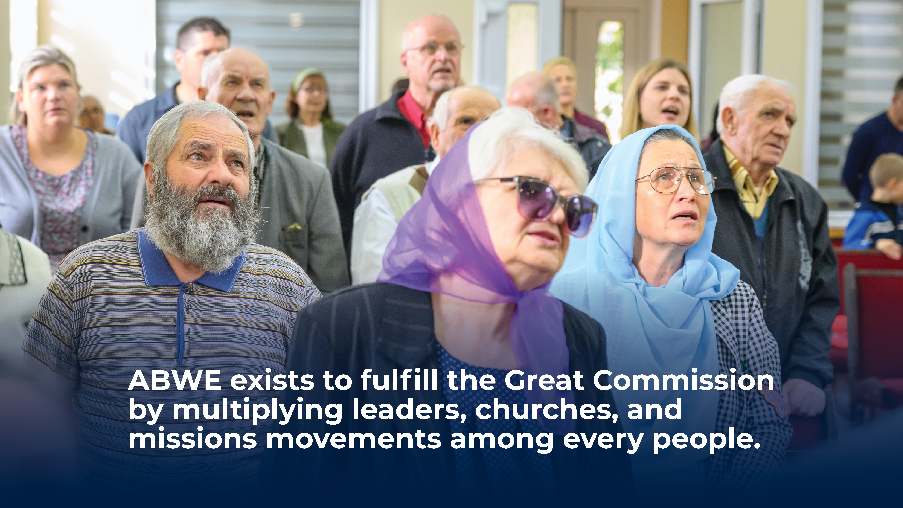

Slide 9
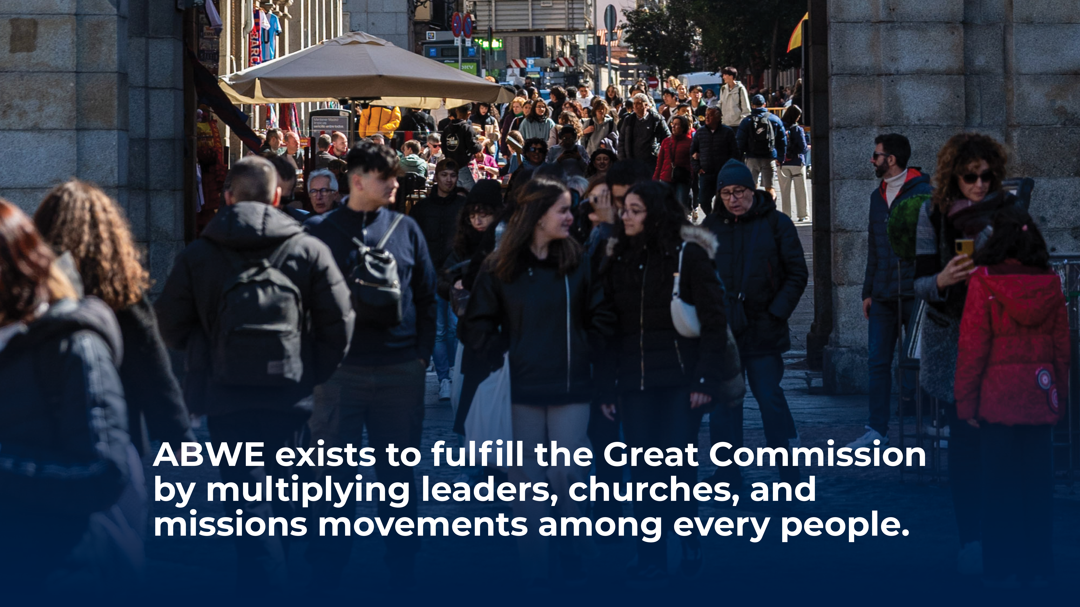

Slide 10
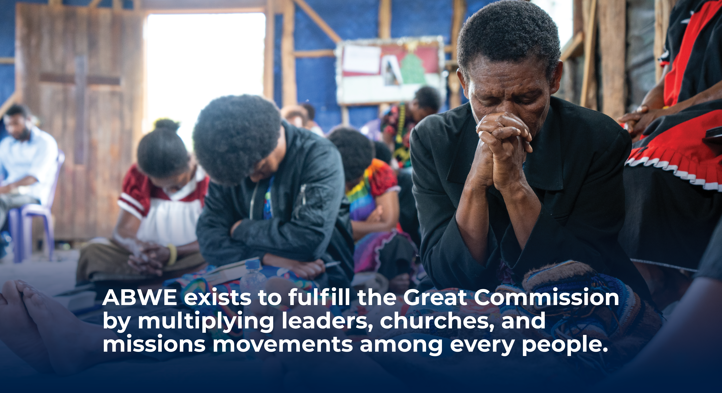

Slide 12
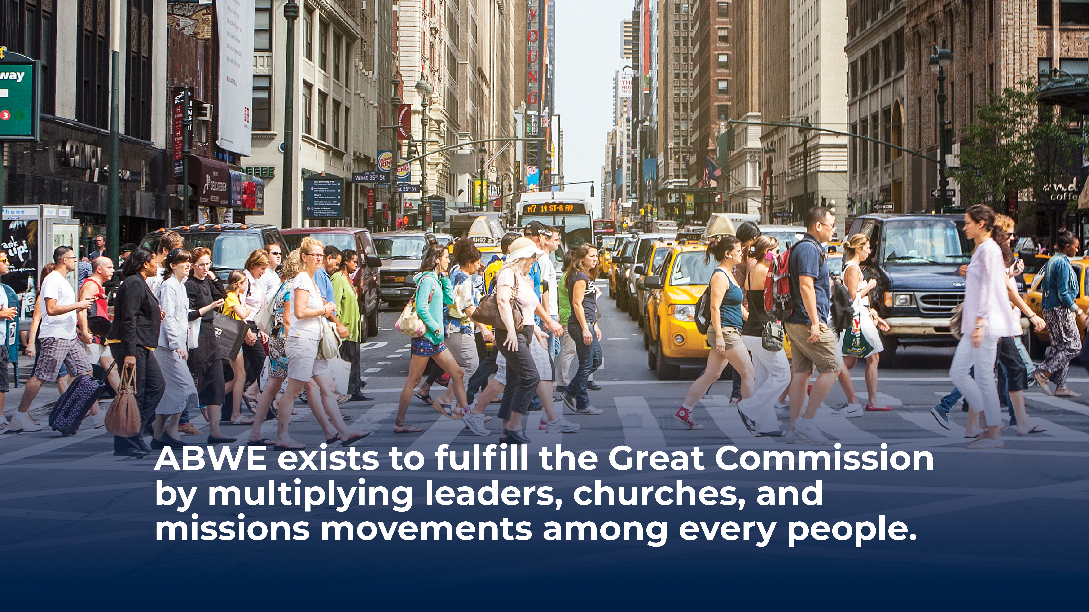

Slide 14

The Global Need
Billions remain unreached by the gospel. In [Country],
[number] million people live in poverty, with limited access to health care and gospel-preaching churches.

Slide 15
Calling & Vision
God has called us to serve in [Country Name] through medical outreach and discipleship. After years in local church ministry, we saw the desperate need for gospel-centered care and pastoral training in [Region].

Slide 16
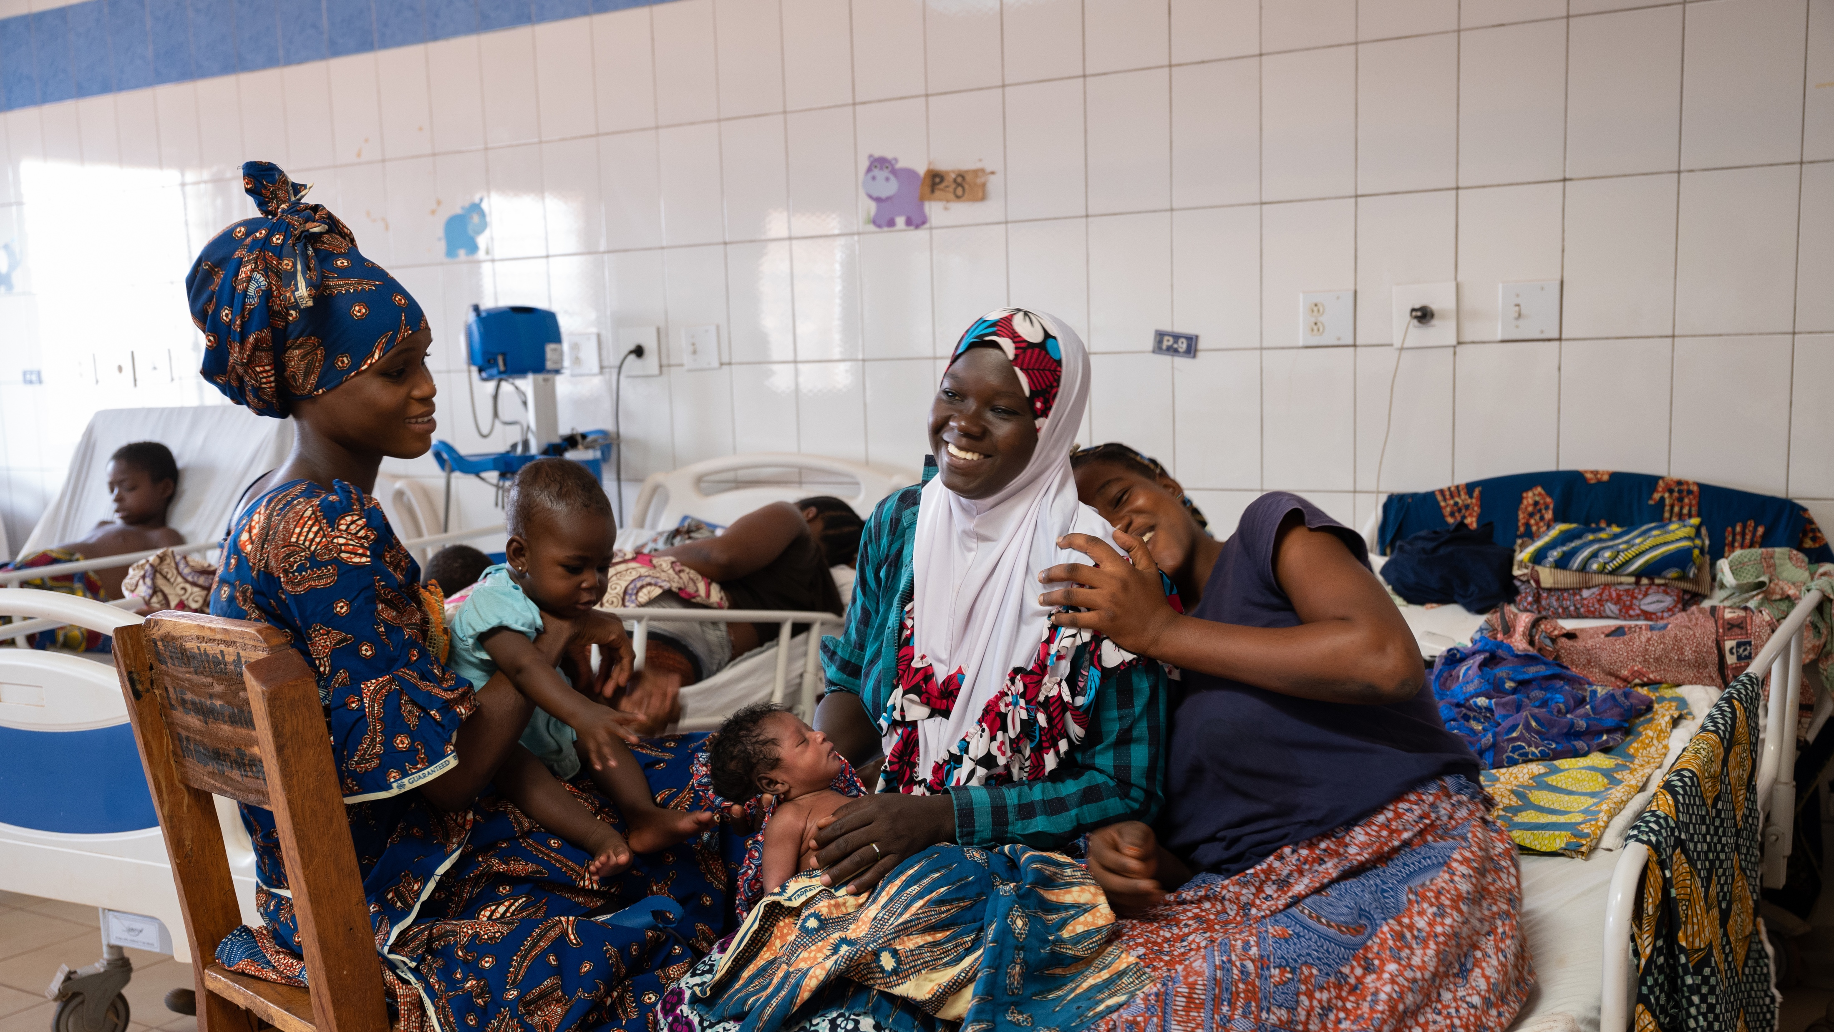
Calling & Vision
God has called us to serve in [Liberia through medical outreach and discipleship. After years in local church ministry, we saw the desperate need for gospel-centered care and pastoral training in West Africa.

Slide 17
Calling & Vision
God has called us to serve in [Liberia through medical outreach and discipleship. After years in local church ministry, we saw the desperate need for gospel-centered care and pastoral training in West Africa.

Slide 18
Ministry Assignment
    Leading mobile medical clinics
    Discipling new believers
    Training pastors
    Helping launch a Christian camp and high school in rural [Country Name}.

Slide 19
Our Approach & Partnership
  We work alongside national believers, mentoring pastors, equipping local leaders, and extending Christ’s compassion through healthcare. Our ministry is part of ABWE’s long-term commitment to multiply healthy churches in [Country Name].

Slide 20
We Need Partners to Sustain our Ministry in Liberia
    25 partners at $25/month = Clinic Supplies
    15 partners at $50/month = Pastoral Training
    10 partners at $100/month = Camp & School Launch

Slide 21

How You Can Join Us
Pray
    For strength and wisdom as we serve in Liberia
Give
    Support gospel-centered medical care and discipleship
Partner
    Join our team through prayer and giving

Slide 22
Our Sending Church
  Pastor’s endorsement quote
We are sent out by [Church name] of [City, State] who stand behind us in prayer and partnership.

Slide 23

Thank you for partnering with us to bring Christ’s hope to [Country Name].
        Contact: john.smith@abwe.org
  “My only aim is to finish the race and complete the task the Lord Jesus has given me—the task of testifying to the good news of God’s grace.”
Acts 20:24

Slide 24
Thank you for partnering with us to bring Christ’s hope to [Country Name].
        Contact: john.smith@abwe.org
  “My only aim is to finish the race and complete the task the Lord Jesus has given me—the task of testifying to the good news of God’s grace.”
Acts 20:24

Slide 25
        Contact: john.smith@abwe.org
Thank you for partnering with us to bring Christ’s hope to [Country Name].
  “My only aim is to finish the race and complete the task the Lord Jesus has given me—the task of testifying to the good news of God’s grace.”
Acts 20:24

Slide 26
Thank you for partnering with us to bring Christ’s hope to [Country Name].
        Contact: john.smith@abwe.org
  “My only aim is to finish the race and complete the task the Lord Jesus has given me—the task of testifying to the good news of God’s grace.”
Acts 20:24

Slide 27
Thank you for partnering with us to bring Christ’s hope to [Country Name].
        Contact: john.smith@abwe.org
  “My only aim is to finish the race and complete the task the Lord Jesus has given me—the task of testifying to the good news of God’s grace.”
Acts 20:24

